Slide 1
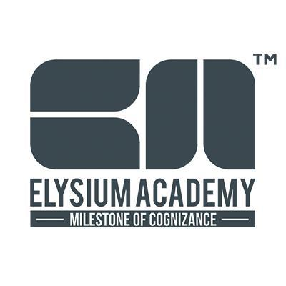

Slide 2
About ELysium Academy
Elysium Academy Private Limited was established in 2012 by the Elysium Group of Companies. It’s a technology hub that offers a comprehensive array of International Certification courses.
We promote Indian students on a global platform. Our customized courses equip students with the advanced technological skills that can transform their career dreams into reality.

Slide 3
About ELysium Academy
We have an astounding Success Rate of more than 7000 of our students becoming Certified Ethical Hackers , CCNP Network Professionals , and MCSE Solutions Expert through our Academy. We also boast tie-ups with 75+ corporates and 200+ colleges. We boast academic partnerships with global tech giant companies in programming ( coding ) , software ( web site development ) and testing and networking and database such as Python , Cisco , Oracle , Microsoft , CompTIA , AWS,SQL etc .

